Slide 1

Cross Join / Cartesian Join
The CROSS JOIN joined every row from the first table (T1) with every row from the second table (T2). In other words, the cross join returns a Cartesian product of rows from both tables.
Infoway Technologies, 3rd Floor Commerce Centre, Rambaug Colony, Paud Road Pune 411038

Slide 2
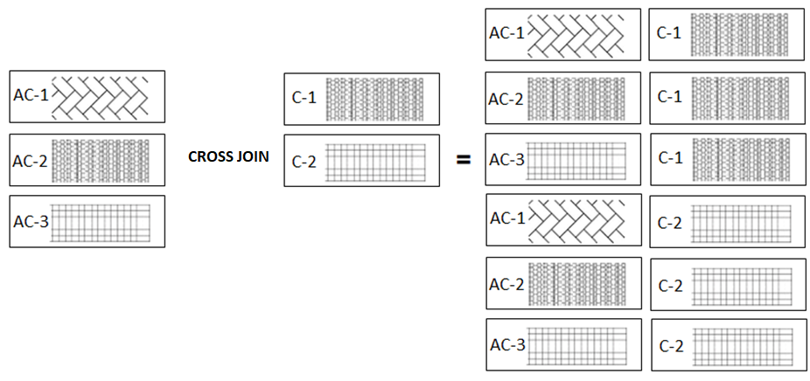
The CROSS JOIN gets a row from the first table (T1) and then creates a new row for every row in the second table (T2). It then does the same for the next row for in the first table (T1) and so on.
Infoway Technologies, 3rd Floor Commerce Centre, Rambaug Colony, Paud Road Pune 411038

Slide 3
Cross Join
syntex
SELECT column-list from <table_references> CROSS JOIN <table_references>

